Slide 1
Trends In Network Industry - Exploring Possibilities for IPAC Network
Steven Lo

Slide 2
History
Token Rings/Thick Ethernet
5Mbs
Shared Hubs
10Mbs
100Mbs
ATM
155Mbs
Group Switching
100Mbs
1000Mbs

Slide 3
Ethernet Switching and Virtual LAN
Breakthrough / ground breaking technology
Provide fault tolerance, traffic flow control and content filtering
Non-sharing, concurrent multiple connections
Solve congestion of the shared network
ASIC hardware to improve performance over software
Support virtual and private network
Software configuration, easy management
Change system from subnet to subnet with one simple command

Slide 4
10 Gigabit/sec
Enabling technology
10-fold bandwidth increase over Gigabit
Gaining popular as cost reduced drastically
Server consolidation and virtualization
Allow server to scale to larger number of processors (or VM)
Address N -> 1 congestion issue
LAN, SAN storage and cluster convergence
Currently being used by backup and clustering applications at IPAC

Slide 5
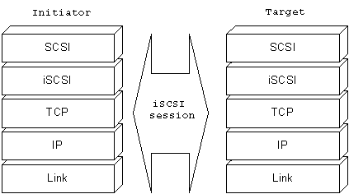
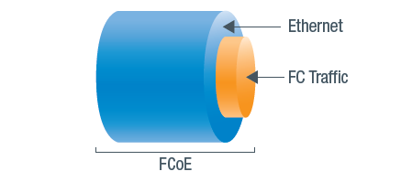
Network-based storage
iSCSI (Internet Small Computer System Interface)
Encapsulate SCSI command over ethernet network (TCP)
Move from direct attach to network attach
Single IP protocol
FCoE (Fiber Channel over Ethernet)
Encapsulate Fiber Channel frames over ethernet network
Unified Communication
Simplify data center cabling
Reduce heat and energy
Fiber Channel will be in a catch up situation in term of speed (8Gbs vs. 10Gbs)
10Gbs cost goes down – FC cost goes up
CEE (Converged Enhanced Ethernet) and DCB (Data Center Bridging)

Slide 6
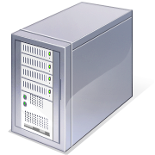
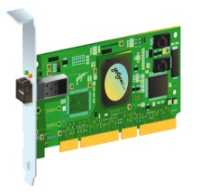
iSCSI
iSCSI SAN Components
Application Server
Ethernet Switch
Ethernet adapter
iSCSI Target Storage Device
iSCSI Initiator
Ethernet cabling

Slide 7
FCoE Converged Network

Slide 8
FCoE

Slide 9
Converged Enhanced Ethernet (CEE)

Slide 10
Virtualization Support
System Virtualization
Industry predicted 50% applications will be virtualized in the next few years (by 2012)
Manage network interface becomes difficult
Each hypervisor has it’s own management scheme – no standardization
VEPA (Virtual Ethernet Port Aggregator)
Move networking from virtual servers to dedicated Ethernet switches
Centralize networking in dedicated equipments for better performance, security and management
Reduce the computing overhead on virtual servers as they scale to support more virtual machines

Slide 11
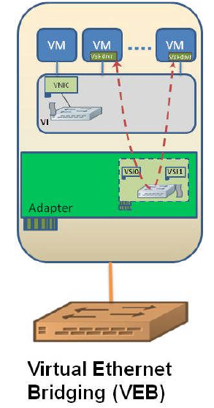
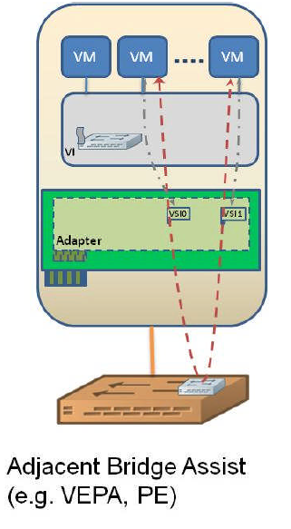

Slide 12
Wireless
Catching up with wired speed
Mobility is the key
802.11n
Backward compatible with a/b/g wireless
MIMO (Multiple Input Multiple Output)
2 to 3 simultaneous data streams
Standard for all modern laptops
Over 100Mbs and can reach 300Mbs
600Mbs is coming
Switching controller with dumb AP (access point)
Concurrent multiple connections

Slide 13
What Else to Explore
40 Gigabit/sec and 100 Gigabit/sec
Wireless 802.11ad
Gigabit Wireless (WiGig) - Wireless Gigabit Alliance
60 GHz, short-range super-fast data transfers
Video/Audio/Data on single large pipe
InfiniBand / HPC / Clustering
Converge wired and wireless data

